Slide 1
Groves AI Solutions:
Automating Front Desk Operations for Small Businesses
Groves AI Solutions transforms your front desk with smart AI systems that work 24/7.
Elite Chatbot
Elite Concierge
Voice AI Receptionist
Intelligent customer service that answers questions instantly, 24/7/365
Smart scheduling system that eliminates booking errors and no-shows
Professional phone handling that routes calls and answers basic questions

Slide 2
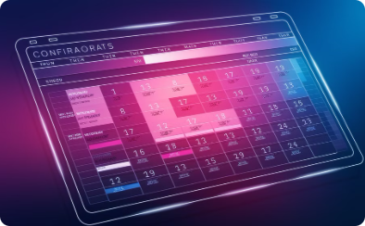
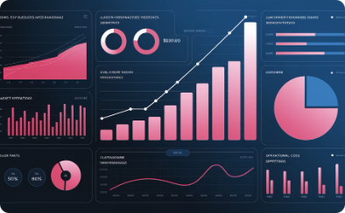
Company Overview
Capture More Leads
Automate Scheduling
Eliminate Missed Calls
Operate Lean
Never miss an opportunity with 24/7 response capability.
Built by founders who scaled a $7B+ business in just 8 years.
Eliminate the back-and-forth of appointment setting.
Every caller gets immediate attention, any time.

Slide 3
The Problem
$80K
Annual Waste
Typical cost of front desk operations for small businesses
40%
Missed Calls
Potential customers lost when calls go unanswered
12hrs
Daily Coverage
Maximum hours traditional staff can work
35%
Budget Drain
Portion of overhead spent on administrative payroll

Slide 4
Our Solution
Transform your front desk operations with our comprehensive AI ecosystem that works tirelessly 24/7/365 without breaks, sick days, or overtime
Groves Elite Chatbot
Advanced NLP-powered AI that instantly engages website visitors with 98.7% accuracy, answering complex questions and capturing qualified leads even at 3AM
Reduces missed opportunities by 78% while converting 42% more website visitors into leads
Collects visitor information and integrates directly with your CRM system within seconds
Groves Elite Concierge
Intelligent scheduling system with proprietary multi-point confirmation technology that eliminates double-bookings, reduces no-shows by 85%, and syncs with Google, Outlook, and iCal
Sends personalized SMS and email reminders with custom timing sequences based on client behavior patterns
Handles complex rescheduling requests with zero staff intervention, saving 12+ admin hours weekly
Groves Voice AI Receptionist
Human-like voice assistant with advanced natural language processing that answers calls in your brand voice, routes complex inquiries, and creates detailed customer profiles from conversations
Provides continuous 24/7/365 coverage, handling 92% of routine inquiries without human intervention
Reduces administrative payroll costs by up to 62%, eliminating the need for multiple front desk staff positions

Slide 5
What You're Paying vs What You'll Save
Replace traditional staffing with Groves AI solutions and save over $121,000 annually - that's 83% in cost reduction across all front desk operations.
Our AI solutions deliver dramatic ROI compared to traditional staffing costs. See exactly how much your business could save annually:
Fees:
One-Time Setup Fees:
Elite: $2,499
Elite Concierge: $3,299
Voice AI: $2,499 (Combine Voice AI with Elite Concierge and get $1000 off total setup!)
Monthly Maintenance Fees (per chart)
All pricing is a starting rate and can vary based on your business size and needs.
Feature
Traditional Cost
Groves AI Solution
Annual Savings
Elite Chatbot
$42,000/year (Part-time rep)
$7,188/year ($599/mo)
$34,812 (83% savings)
Elite Concierge
$58,000/year (Full-time scheduler)
$11,988/year ($999/mo)
$46,012 (79% savings)
Voice AI Receptionist
$45,000/year (Receptionist)
$7,188/year ($599/mo)
$37,812 (84% savings)
Total Potential
$145,000/year
$26,364/year
$118,636 (82% savings)
Based on average small business salaries, including benefits and operational costs. ROI typically achieved within the first 45 days.

Slide 6
What Each Product Replaces
Groves Elite (Chatbot)
Groves Elite Concierge
Groves Voice AI
Receptionists
Appointment Setters
Phone Receptionists
Customer Service Reps
Admin Assistants
After-Hours Support
Sales Assistants
Personal Assistants
Voicemail Staff

Slide 7
Why Choose Groves AI?
$7B+ Business Proof
24/7 Availability
Faster Response Times
Fully Managed Solution
Same tools that built our successful company
Never miss opportunities during off-hours
Instant engagement converts more leads
White-labeled and professionally maintained

Slide 8
Book Your Demo Today
Start your journey to dramatic cost savings with these simple steps:
Schedule a 10-Minute Demo
Review Your Savings
Custom Implementation
Get a detailed breakdown of your cost reduction
We'll tailor a solution for your specific business needs
See Groves AI in action with personalized walkthrough
Visit grovescapital.com/ai to get started today.

